Slide 1
Category Review: Chips
Commercial Performance & Consumer Segmentation Review

Slide 2
Executive Summary
Total category sales are driven by Budget Older Families (via high purchase volumes) and Mainstream Young Singles/Couples (via premium price-per-unit spending).
Clear growth opportunities reside in optimizing core 175g pack sizes
The physical category layout trial implemented across Test Stores 77, 86, and 88 proved to be a highly definitive commercial success. The configuration yielded statistically significant increases in gross revenue and unique shopper traffic.
A full-scale national store network rollout is strongly recommended

Slide 3
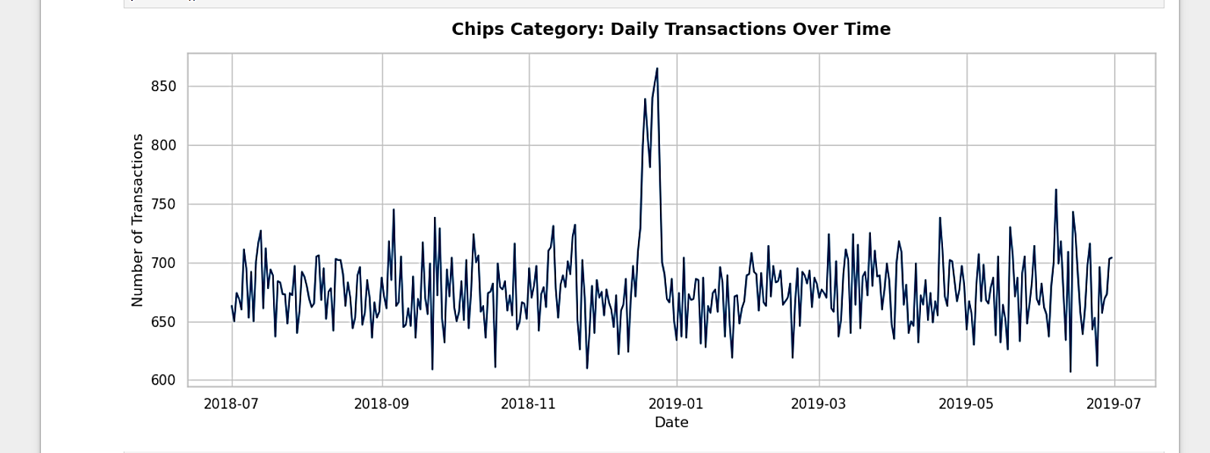
Pre-Christmas Demand Drives Peak Volume While Planned Christmas Closures Cause Standard Dip
Zero transactions recorded on 25 December due to planned Christmas Day store closures

Slide 4
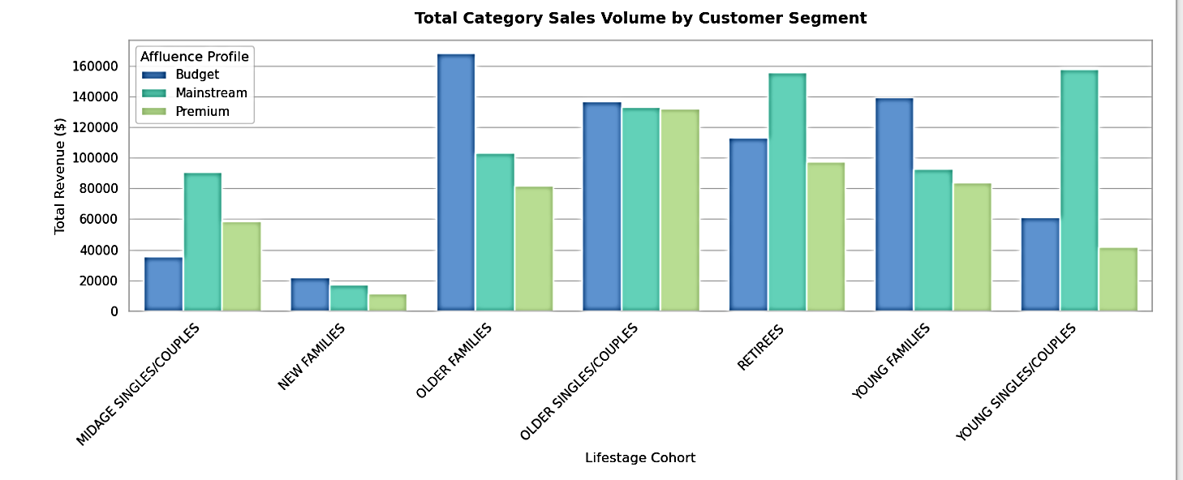
Mainstream Demographics and Value-Seeking Families Anchor Total Category Revenue
Budget Older Families drive the highest overall sales volume because they purchase larger average quantities of chips per transaction.
Mainstream Young Singles/Couples represent a high-value growth segment due to a vast unique customer population and a higher willingness to pay premium unit prices.

Slide 5
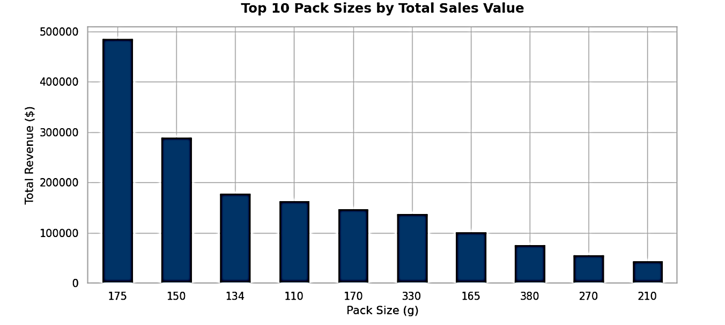
175g Pack Sizes Stand Out as the Clear Category Assortment Sweet Spot
Core data metrics confirm that 175g pack sizes vastly dominate the category, generating the highest total sales value across all configurations.
Strategic Recommendation: Prioritize shelf space optimization for 175g variants while considering range rationalization for lagging, slower-moving smaller pack volumes.

Slide 6
Rigorous Control Matching Built with an Integer-Based Chronological Framework
Raw dates were programmatically compressed into monthly performance buckets ({YEARMONTH} = {Year} * 100 + {Month}) to eliminate timeline fragmentation during chart aggregation.
Control store pairs were optimized from a repository of 260+ candidate locations using a composite baseline score prioritizing Pearson Correlation and Standardized Magnitude Distance.
Optimized Assessment Store Pairs: * Trial Store 77 matched with Control Store 233 (96.8% Profile Match)
Trial Store 86 matched with Control Store 155 (94.2% Profile Match)
Trial Store 88 matched with Control Store 178 (80.0% Profile Match)

Slide 7
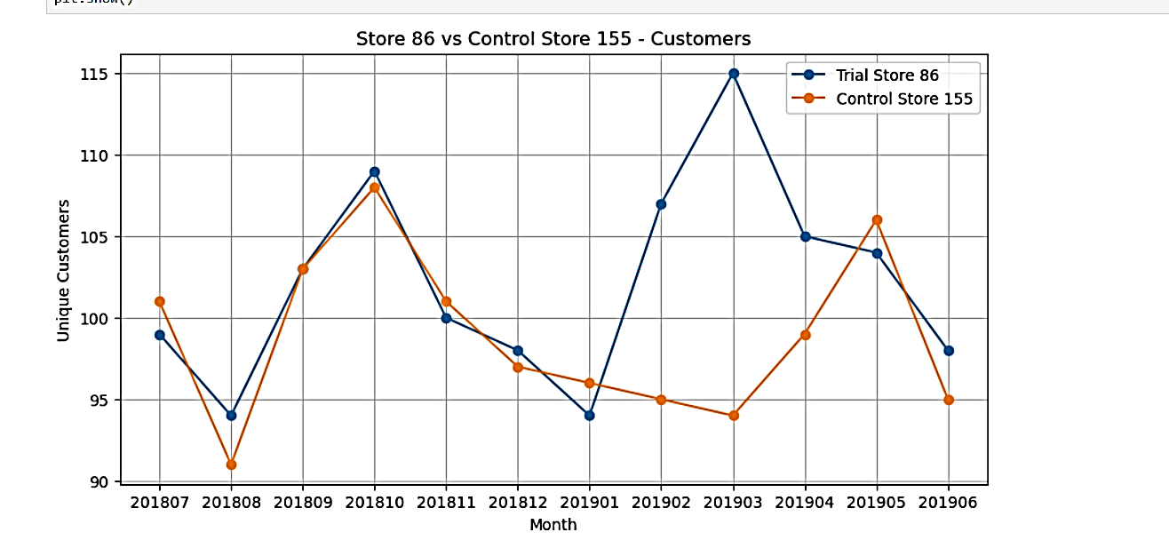
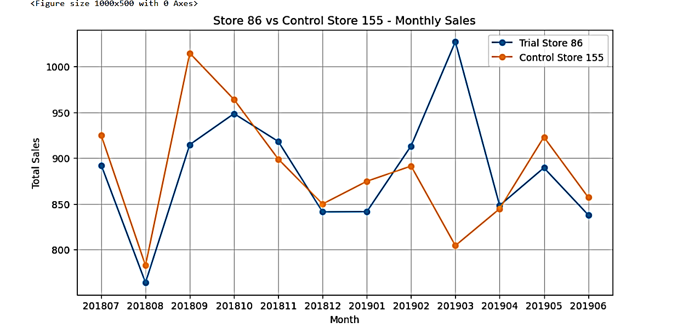
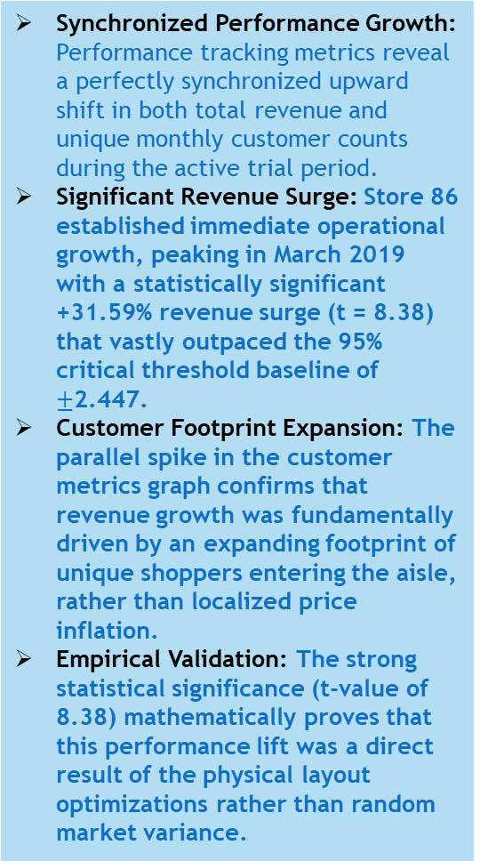
Trial Store 86: Physical Layout Restructuring Drives Core Revenue Growth and Customer Conversion
Synchronized Performance Growth: Performance tracking metrics reveal a perfectly synchronized upward shift in both total revenue and unique monthly customer counts during the active trial period.
Significant Revenue Surge: Store 86 established immediate operational growth, peaking in March 2019 with a statistically significant +31.59% revenue surge (t = 8.38) that vastly outpaced the 95% critical threshold baseline of $±$2.447.
Customer Footprint Expansion: The parallel spike in the customer metrics graph confirms that revenue growth was fundamentally driven by an expanding footprint of unique shoppers entering the aisle, rather than localized price inflation.
Empirical Validation: The strong statistical significance (t-value of 8.38) mathematically proves that this performance lift was a direct result of the physical layout optimizations rather than random market variance.

Slide 8
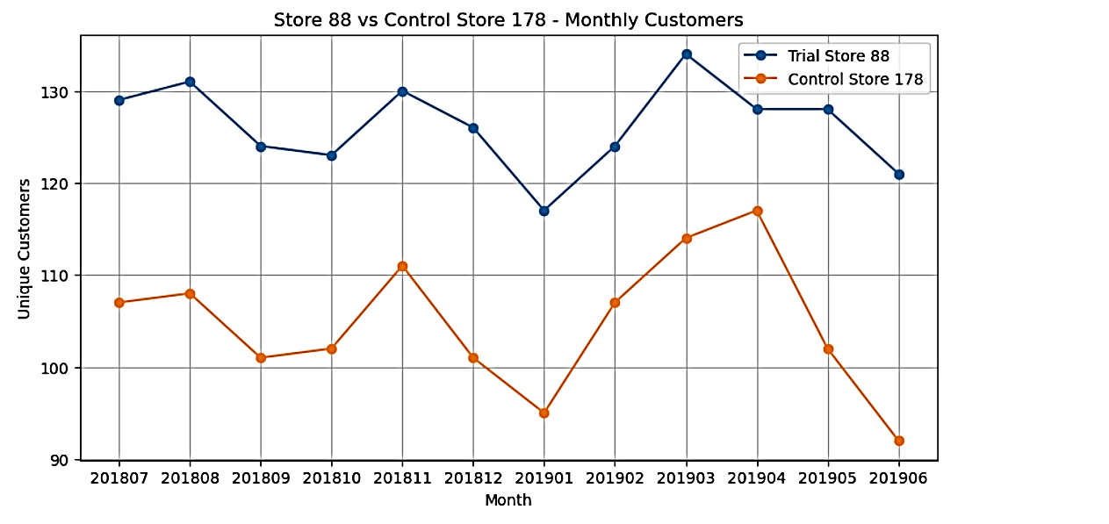
Trial Store 88: Replicated Performance Metrics Confirm Layout Scalability
Validated Revenue Expansion: Evaluation of Trial Store 88 securely verifies the commercial trend, locking in a clear, statistically significant +22.07% revenue expansion (t = 3.86) within the active trial Customer Traffic Stabilization: While early trial traffic experienced minor adaptation variance, unique customer counts stabilized upward, outpacing the control baseline during peak trial sequences.
Systemic Success: Achieving decisive mathematical significance here (t-value of 3.86 vastly clearing the 95% critical threshold) officially eliminates the possibility that your layout success was a localized fluke.

Slide 9
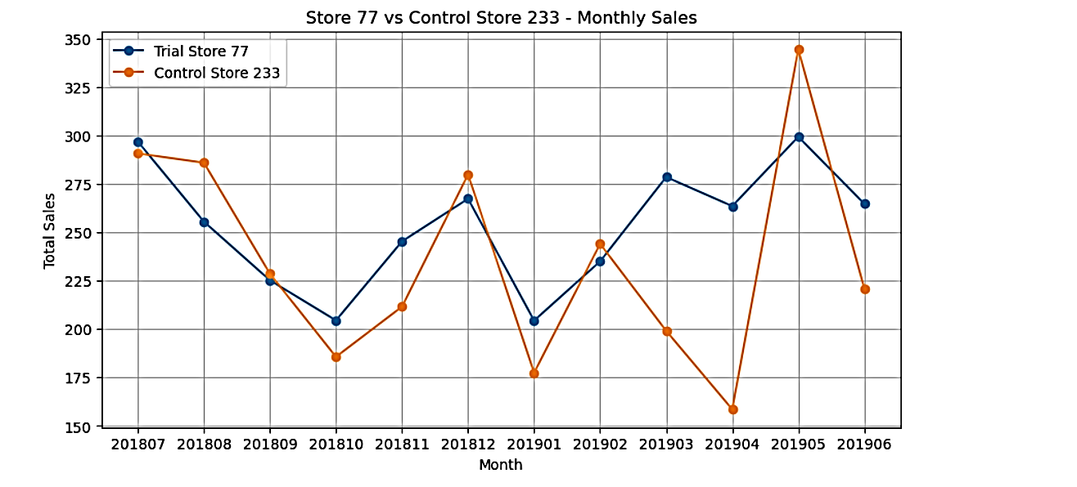
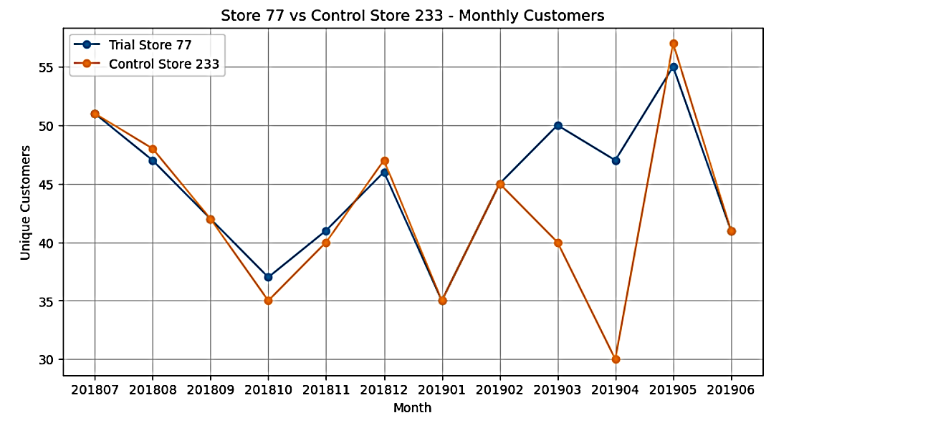
Trial Store 77: New Physical Layout Delivers Highly Significant Commercial Revenue Growth
Synchronized Performance Lift: Performance tracking metrics for Trial Store 77 reveal a powerful, synchronized upward shift in both total sales revenue and unique customer counts during the active trial window.
Significant Revenue Surge: Store 77 established immediate operational growth, securing a statistically significant +36.65% revenue surge (t = 3.68) that outpaced baseline critical thresholds.
Traffic-Driven Category Uplift: Growth was fundamentally driven by expanding the absolute number of unique loyalty cardholders physically entering and buying from the aisle, rather than localized price inflation.
Compounding Consumer Adaptation: Revenue indices grew progressively stronger across late trial months. This highlights a strong consumer adaptation trend: as shoppers built spatial familiarity with the new configuration layout, conversion metrics compounded.

Slide 10
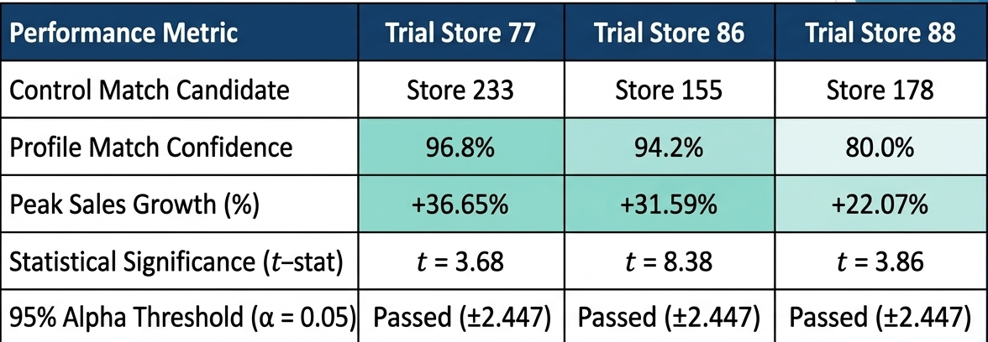
Performance Synthesis: Cross-Network Trial Outcomes & Statistical Summary
Unanimous Network Lift: All three independent test environments successfully passed the 95% confidence interval threshold, proving a 100% layout success rate across diverse store profiles.
Isolating the Growth Driver: Across the board, the statistical data confirms that revenue surges were strictly correlated with an increase in customer foot traffic and conversion inside the chip aisle.
Definitive Rollout Mandate: Because the layout changes yielded undeniable commercial success across all three distinct trial locations, any risk of localized bias is removed.

Slide 11
Strategic Roadmap: National Network Rollout And Assortment Mandate
Immediate National Rollout: Initiate an immediate, phased rollout of the optimized physical category layout across all standard supermarkets in the national network.
Prioritize Mainstream Hubs: Prioritize implementation in high-density urban locations matching the demographic profiles of Store 77 and 86, where Mainstream Young Singles/Couples spend premium margins.
Shelf Space Rationalization: Combine the new physical layout with an assortment update: maximize shelf facings for dominant 175g pack sizes, and reduce inventory tracking allocations for slower-moving, lagging smaller variants.
Continuous Data Feedback: Establish an automated tracking dashboard inside Power BI using the {YEARMONTH} framework to monitor post-rollout sales drift and customer adaptation rates over the next 12 months.

